Slide 1
Best practice disclosure in PDS
Robert Sloan | Gillian Boyes
INFINZ and FMA workshop | 4 & 5 April| Auckland & Wellington

Slide 2
Why did we commission the research?

Slide 3
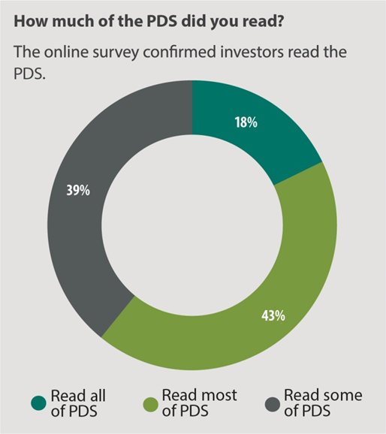
A PDS provides an investment snapshot and guides further research
“I went to the PDS first when I heard about the XYZ IPO. Skimmed through it then took it to my adviser and had a chat with him. Looked online at the company and its management team” - Investor XYZ IPO

Slide 4
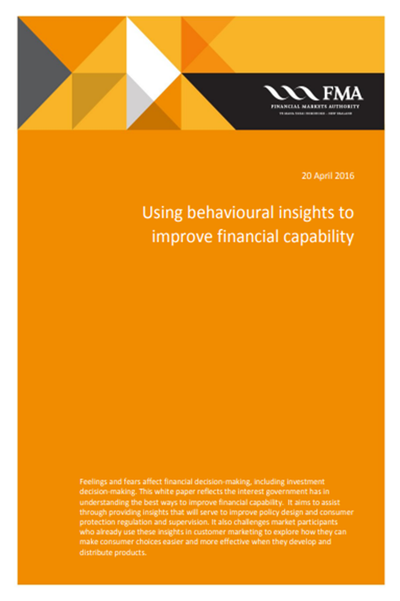
Prior experience leads to more trust in the PDS
“I pretty much just used the PDS and a quick chat with my broker. Had a quick look on Sharetrader and that’s it. I’ve invested in them before; A very well-run company. They’ve always delivered so I had no problem going along with the bond offer.” - Investor, bond offer

Slide 5
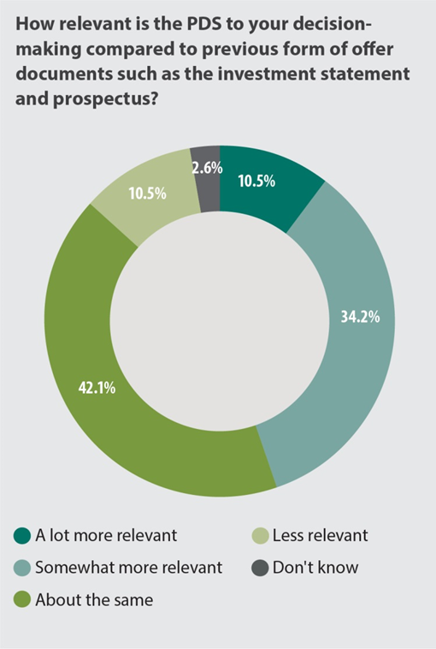
The PDS is an improvement over previous disclosure documents
“I only ever used it online. It’s much better than those prospectuses they had before.”
- Investor, XYZ IPO

Slide 6
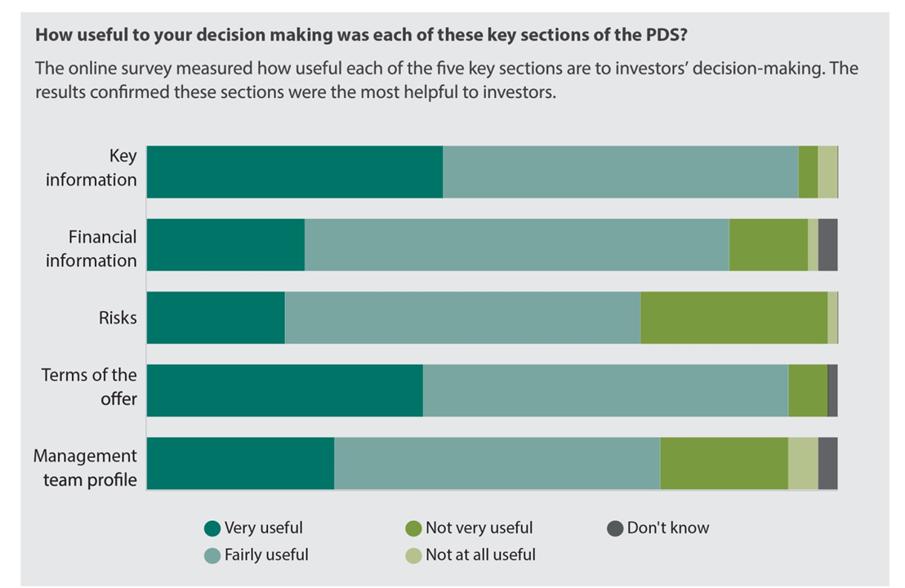
Investors rely on certain key sections

Slide 7
Investor insight – importance of management
“You can see who is what and what they bring to the table. Sometimes you get these companies run by accountants and you think what does an accountant know about building and construction? Why’s he there as a CEO when he probably can’t even tell the difference between a hammer and a screwdriver? So it's good to see what the leadership actually looks like.” - Investor, bond offer

Slide 8
Investor insight – financials are too complex
“I always make a point of looking at the finances. I can fiddle around with the numbers a little bit but not much. P/E ratio, gearing I can do but nothing more. It gets a bit much after a while. I leave that to my broker.” - Investor, property syndicate

Slide 9
Investor insight – risks are too generic
“It's good they have the risks there. It’s transparent and honest right? But you get the sense they’re trying to cover their behinds. Some of that stuff is just so obvious you got to roll your eyes. It's good to have it there though I guess. In case things do go bad.” - Investor, property syndicate

Slide 10
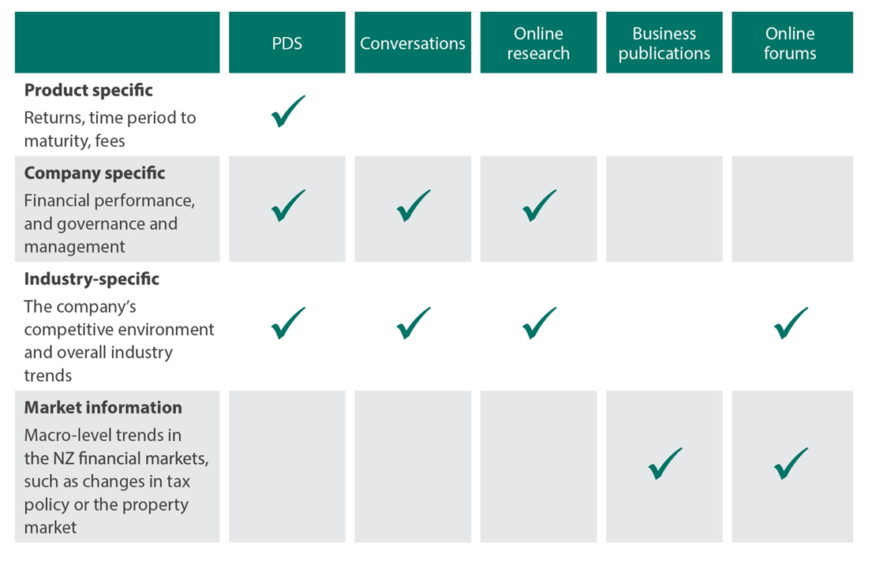
Beyond the PDS

Slide 11
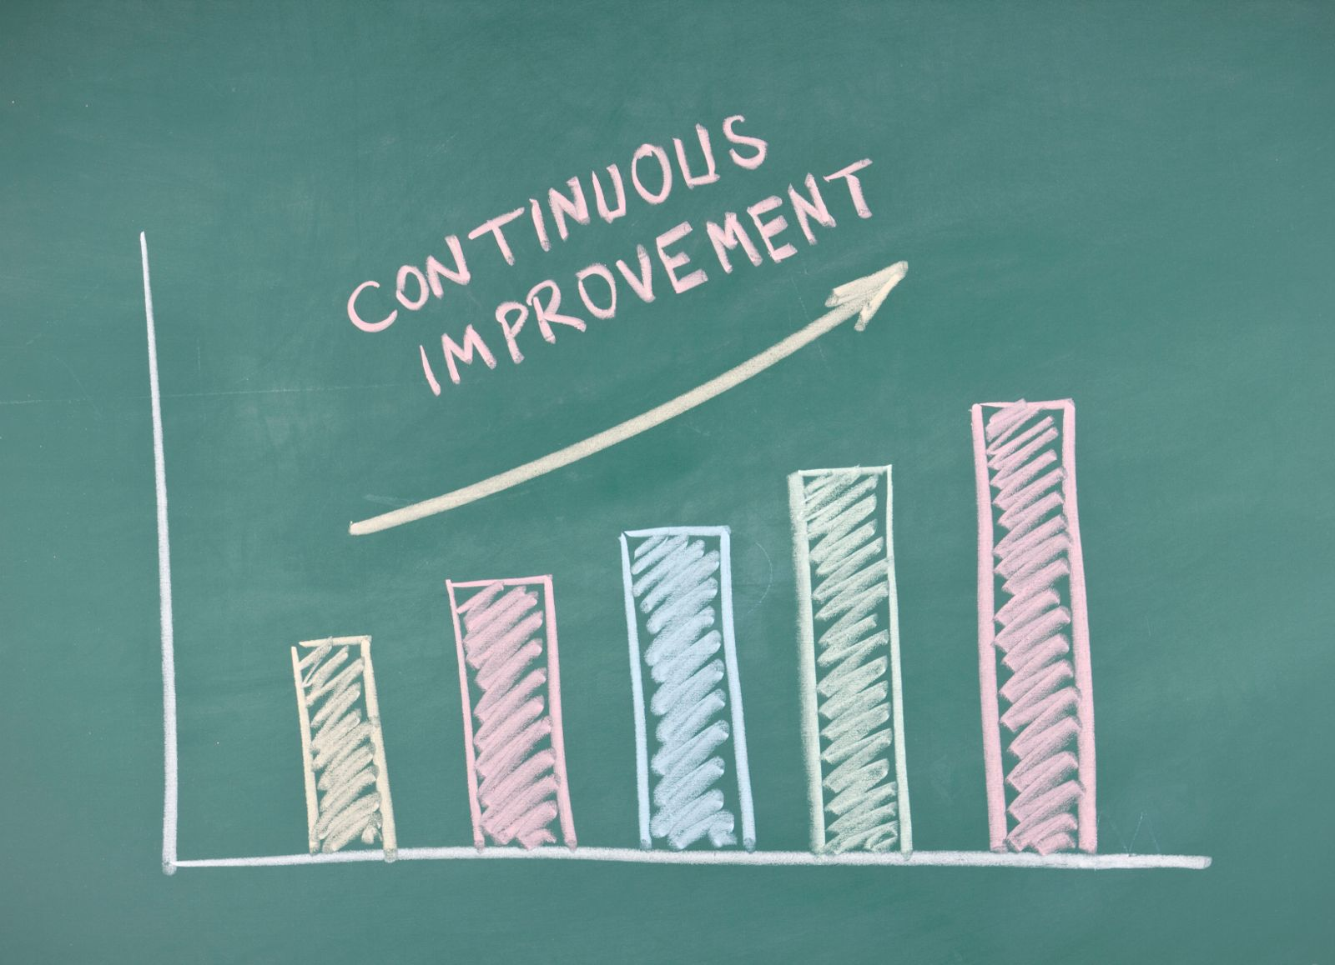
What this means for issuers - improvements

